Slide 1

COP 6731: Theory and Implementation of Database Systems
Concurrency Control

Slide 2
Concurrency
Concurrency control is a mechanism to ensure that the database is updated correctly when multiple users are updating the database concurrently. This avoids inconsistencies from arising when two or more transactions are executing and at least one is updating the database.

Slide 3
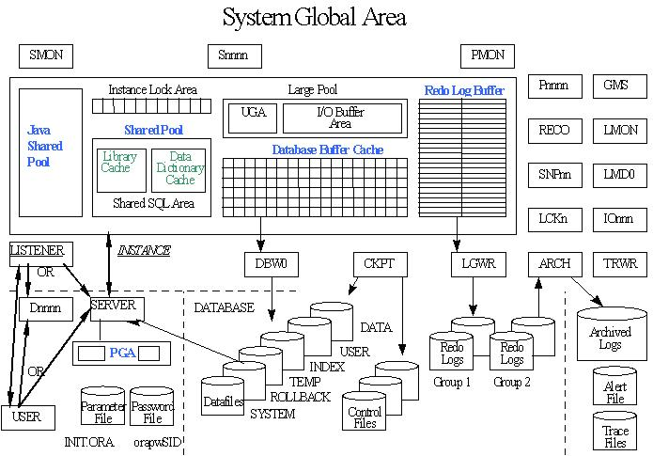
Database Server Architecture

Slide 4
Review
Given a schedule, two operations are conflicting if they satisfy all three following conditions:
They belong to different transactions
They access the same item X
At least one of the operations is write_item(X)
Two types of conflict:
1) read-write (or write-read) conflict
2) write-write conflict

Slide 5
Review
Serial Schedule
Only one transaction at a time is active.
No interleaving occurs.
A schedule S is conflict serializable if it is conflict equivalent to some serial schedule.

Slide 6
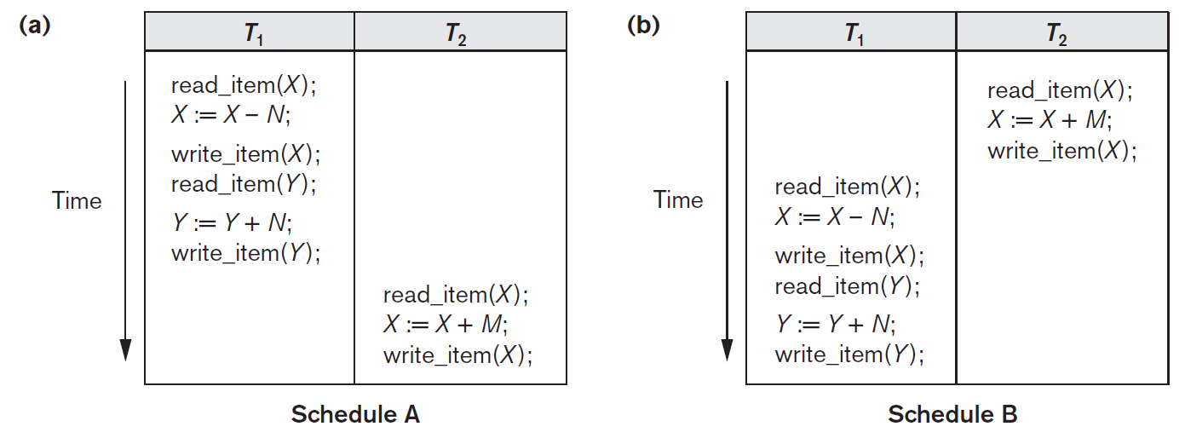
Serial Schedule

Slide 7
Question 1: Is it conflict serializable?
S : R1(X),R2(X),W1(X),R1(Y),W2(X),W1(Y)

Slide 8
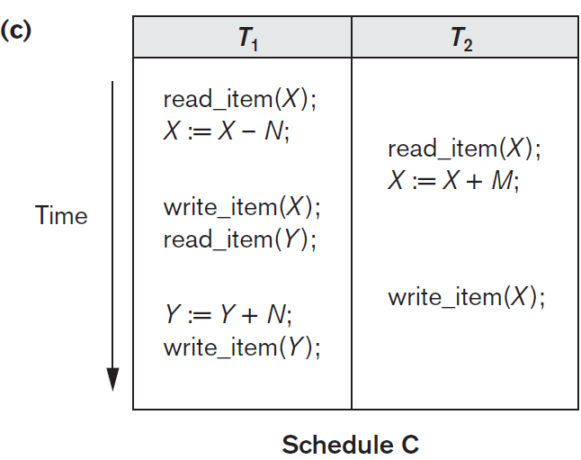
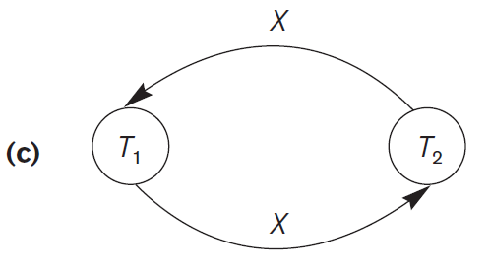
Serialization Graph (Precedence Graph)

Slide 9
Question 2: Is it conflict serializable?
S : R1(X),W1(X),R2(X),W2(Y),R1(Y), AbortT1

Slide 10
Serializable Schedule
Serializable is not the same as Serial.
Serializable schedule implies that the schedule is a correct schedule.
It ensures a consistent database state.
It allows interleaved processing and achieves efficiency due to concurrent execution.

Slide 11
Testing for Serializability of a Schedule
It is impossible to determine when a schedule begins and when it ends.
Hence, we check only committed transactions of the schedule (i.e., operations from only the committed transactions.)
The most common technique is based on locking: two-phase locking

Slide 12
Database Concurrency Control
Purpose of Concurrency Control
To enforce Isolation (through mutual exclusion) among conflicting transactions.
To preserve database consistency.
To resolve read-write and write-write conflicts.

Slide 13
Two-Phase Locking (2PL)

Slide 14
Multiple mode Locks !!
Shared Lock
read_lock(X)
<Item, no. of reads>
Exclusive Lock
write_lock(X)
UnLock
unlock(x)
Conflict Matrix

Slide 15
Two-Phase Locking (2PL)
Two-Phase Locking Techniques:
Two Phases:
(a) Locking (Growing)
(b) Unlocking (Shrinking).
Locking (Growing) Phase:
A transaction applies locks (read or write) on desired data items one at a time.
Unlocking (Shrinking) Phase:
A transaction unlocks its locked data items one at a time.
Requirement:
Given a transaction, two phases (i.e., growing and shrinking phases) must be mutually exclusive, that is, the unlocking phase must not start during the locking phase, and the locking phase must not begin during the unlocking phase.

Slide 16
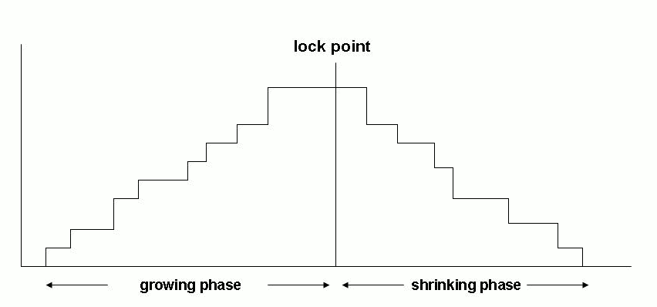
Two-Phase Locking (2PL)
two-phase locking (2PL) is a concurrency control method that guarantees serializability (or conflict-serializability).
Locking and Unlocking can be done in two phases.es.

Slide 17
Conservable 2PL
Conservable 2PL (or static 2PL)
Before the transaction begins execution, a transaction locks all the items it access.
Conservative 2PL is a deadlock-free protocol. But it does not ensure a strict schedule.
Conservative 2PL is difficult to use in practice because of the need to predeclare the read-set and the write-set which is not possible in many situations.

Slide 18
Strict 2PL
Strict 2PL
Transaction T never releases any of its exclusive locks until after it commits or aborts.
Strict 2PL guarantees a strict schedule (i.e., recoverable schedule).
Strict 2PL is recoverable and cascadeless.

Slide 19
Recoverability
T1 | T2
Write(X)
 | Read(X)
Commit
 | Commit
Recoverable Schedule
Cascadeless Schedule (no cascading rollback)
A cascadless schedule allows transactions to only read committed data
T1 | T2
Write(X)
Commit
 | Read(X)
Every cascadeless schedule is recoverable.

Slide 20
Recoverability (Example)
T1 | T2
Read(A)
Write(A)
 | Read(A)
 | Commit
Abort
T1 | T2 | T3
Read(A)
Read(B)
Write(A)
Commit
 | Read(A)
 | Write(A)
 | Commit
 |  | Read(A)
 |  | Commit
(a) Abort T1
Is it a recoverable schedule?
Is it a cascadeless schedule?
(b) Recoverable ?

Slide 21
Two-Phase Locking
Two-Phase Locking
T1 T2
read_lock (Y);
read_item (Y);
unlock (Y);
read_lock (X);
read_item (X);
unlock (X);
write_lock (Y);
read_item (Y);
Y:=X+Y;
write_item (Y);
unlock (Y);
write_lock (X);
read_item (X);
X:=X+Y;
write_item (X);
unlock (X);
Result
This schedule violates the two-phase policy.
Time
Inconsistent state

Slide 22
Two-Phase Locking
Two-Phase Locking Techniques:
T1 T2
read_lock (Y); read_lock (X);
read_item (Y); read_item (X);
write_lock (X); write_lock (Y);
unlock (Y); unlock (X);
read_item (X); read_item (Y);
X:=X+Y; Y:=X+Y;
write_item (X); write_item (Y);
unlock (X); unlock (Y);

Slide 23
Deadlock
Dealing with Deadlock and Starvation
Deadlock
T1 T2
read_lock (Y); T1 and T2 follow two-phase locking
read_item (Y); policy but they are deadlock.
read_lock (X);
read_item (Y);
write_lock (X);
(waits for X) write_lock (Y);
(waits for Y)
Deadlock (T1 and T2)

Slide 24
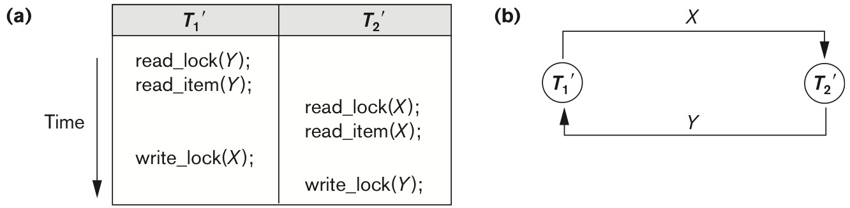
Deadlock detection

Slide 25
Deadlock detection
T1 | T2 | T3 | T4
read_lock(A)
Read(A)
 | write_lock(B)
 | Write(B)
read_lock(B)
Read(B)
 |  | read_lock(C)
 |  | Read(C)
 | write_lock(C)
 | Write(C)
 |  |  | write_lock(B)
 |  |  | Write(B)

Slide 26

Deadlock detection
T1 | T2 | T3 | T4
read_lock(A)
Read(A)
 | write_lock(B)
 | Write(B)
read_lock(B)
Read(B)
 |  | read_lock(C)
 |  | Read(C)
 | write_lock(C)
 | Write(C)
 |  |  | write_lock(B)
 |  |  | Write(B)
T1
T2
T3
T4
Data Item | T1 | T2 | T3 | T4 | WaitList
A | S
B |  | X |  |  | T1,T4
C |  |  | S |  | T2

Slide 27
Deadlock detection
T1 | T2 | T3 | T4
Read_lock(A)
Read(A)
 | Write_lock(B)
 | Write(B)
Read_lock(B)
Read(B)
 |  | Read_lock(C)
 |  | Read(C)
 | Write_lock(C)
 | Write(C)
 |  |  | Write_lock(B)
 |  |  | Write(B)
 |  | Write_lock(A)
 |  | Write(A)
T1
T2
T3
T4
Data Item | T1 | T2 | T3 | T4 | WaitList
A | S
B |  | X |  |  | T1,T4
C |  |  | S |  | T2

Slide 28
Deadlock detection
T1 | T2 | T3 | T4
Read_lock(A)
Read(A)
 | Write_lock(B)
 | Write(B)
Read_lock(B)
Read(B)
 |  | Read_lock(C)
 |  | Read(C)
 | Write_lock(C)
 | Write(C)
 |  |  | Write_lock(B)
 |  |  | Write(B)
 |  | Write_lock(A)
 |  | Write(A)
T1
T2
T3
T4
Data Item | T1 | T2 | T3 | T4 | WaitList
A | S |  |  |  | T3
B |  | X |  |  | T1,T4
C |  |  | S |  | T2

Slide 29
Deadlock detection and Resolution
Dealing with Deadlock
Deadlock detection and resolution
It allows deadlocks, but the scheduler maintains a wait-for-graph for detecting the cycle. If we find a cycle, we can select one transaction (i.e., victim) in the cycle and roll back the selected transaction.
Wound-Wait and Wait-Die algorithms use timestamps to avoid deadlocks using a rollback of the victim.

Slide 30
Deadlock prevention
Dealing with Deadlock
Deadlock prevention
A transaction locks all data items before it begins execution (i.e., conservative 2PL).
Conservative 2PL prevents deadlock since transactions never wait for data item.

Slide 31
Deadlock resolution
Wait-Die
T1 | T2
Start
 | Start
 | Lock(A)
Lock(A)
T1 | T2
 | Start
Start
 | Lock(A)
Lock(A)
T1 waits
Abort T1
Wound-Wait
T1 | T2
Start
 | Start
 | Lock(A)
Lock(A)
T1 | T2
 | Start
Start
 | Lock(A)
Lock(A)
Abort T2
T1 waits
Both schemes end up aborting the younger of the two transactions that may be involved in a deadlock. The oldest transaction has the highest priority.

Slide 32
Database Concurrency Control
Dealing with Deadlock and Starvation
Starvation
Starvation occurs when a particular transaction consistently waits or restarted and never gets a chance to proceed further.
In a deadlock resolution, it is possible that the same transaction may consistently be selected as victim and rolled-back.
This limitation is inherent in all priority-based scheduling mechanisms.
In Wound-Wait scheme a younger transaction may always be wounded (aborted) by a long running older transaction which may create starvation.

Slide 33
Multiple Granularity

Slide 34
Multiple Granularity
Example of data item granularity:
Database
File
Block (or page)
Record (or tuple)
Field of a record (or attribute of a tuple)
The larger the data item size is, the lower the degree of concurrency.
The smaller the data item size is, the more the number of active locks to be handled by the lock manager. (We need more storage space for the lock table !!)

Slide 35
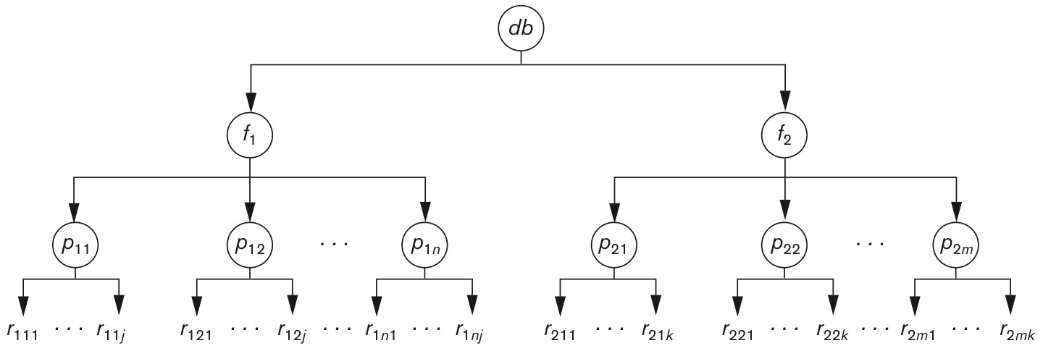
Multiple Granularity
Granularity of data items and Multiple Granularity Locking
The following diagram illustrates a hierarchy of granularity from coarse (database) to fine (record).

Slide 36
Examples
T1: update all the records in f1 (exclusive lock).
T2: read record r1 (shared lock).
Case 1: T1 → T2
Case 2: T2 → T1
db
f1
f2
p1
p2
p3
p3
r1
r2
r3
r4
r5
r6
r7
r8

Slide 37
Multiple Granularity
The Granularity of data items and Multiple Granularity Locking
Put Intention Locks to all the ancestors of a node before that node is locked.
Intention-shared (IS): indicates that shared lock(s) will be requested on some descendent nodes(s).
Intention-exclusive (IX): indicates that an exclusive lock(s) will be requested on some descendent node(s).
Shared-intention-exclusive (SIX): indicates that the current node is locked in shared mode but an exclusive lock(s) will be requested on some descendent nodes(s).

Slide 38
Multiple Granularity
Each transaction starts from the root of the hierarchy
To get S or IS lock on a node, must hold IS or IX on the parent node.
To get X, IX, or SIX on a node, must hold IX or SIX on the parent node.
Must release locks in bottom-up order.

Slide 39
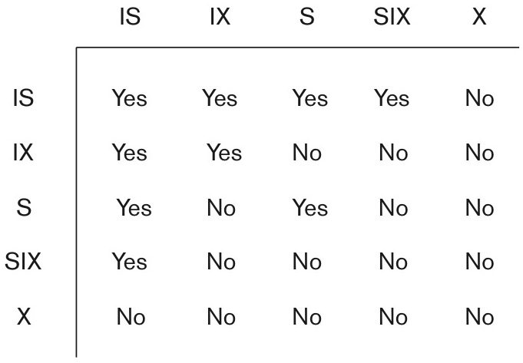
Database Concurrency Control
The granularity of data items and Multiple Granularity Locking
These locks are applied using the following compatibility matrix:
Intention-shared (IS)
Intention-exclusive (IX)
Shared-intention-exclusive (SIX)

Slide 40
Database Concurrency Control
Granularity of data items and Multiple Granularity Locking
The set of rules for a serializable schedule is
The lock compatibility must adhere to.
The root of the tree must be locked first, in any mode.
A node N can be locked by a transaction T in S or IX mode only if the parent node is already locked by T in either IS or IX mode.
A node N can be locked by T in X, IX, or SIX modes only if the parent of N is already locked by T in either IX or SIX modes.
T can lock a node only if it has not unlocked any node (to enforce 2PL policy).
T can unlock a node, N, only if none of the children of N are currently locked by T.

Slide 41
Examples
T1 reads record r1.
Lock db, f1, p1 in IS mode
Lock r1 in S mode
T2 updates record r2.
Lock db, f1, p1 in IX mode
Lock r2 in X mode
T3 reads all the records in p1
Lock db, f1 in IS mode
Lock p1 in S mode
T4 reads all the records in db
Lock db, f1 in IS mode
Lock db in S mode
db
f1
f2
p1
p2
p3
p3
r1
r2
r3
r4
r5
r6
r7
r8

Slide 42
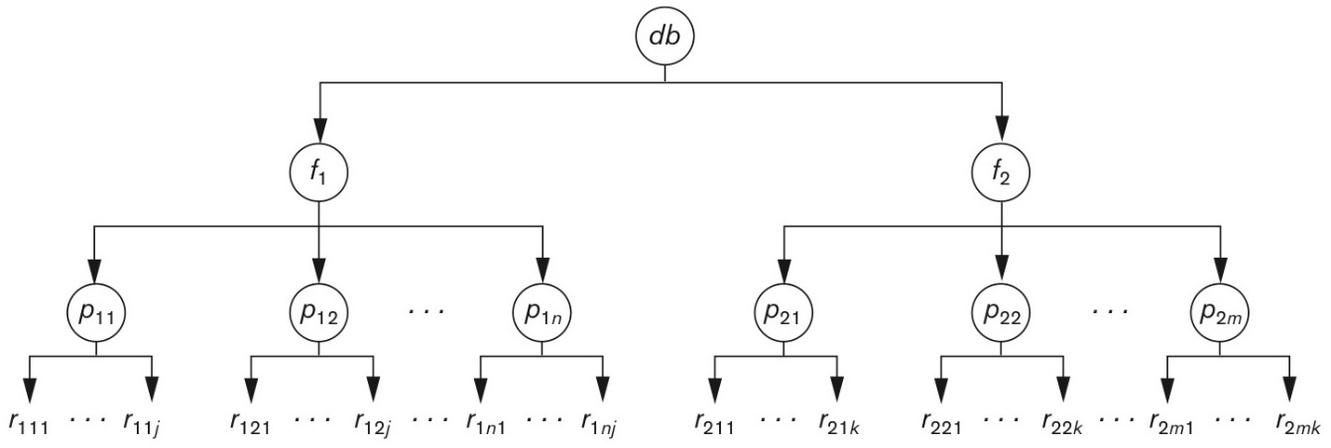
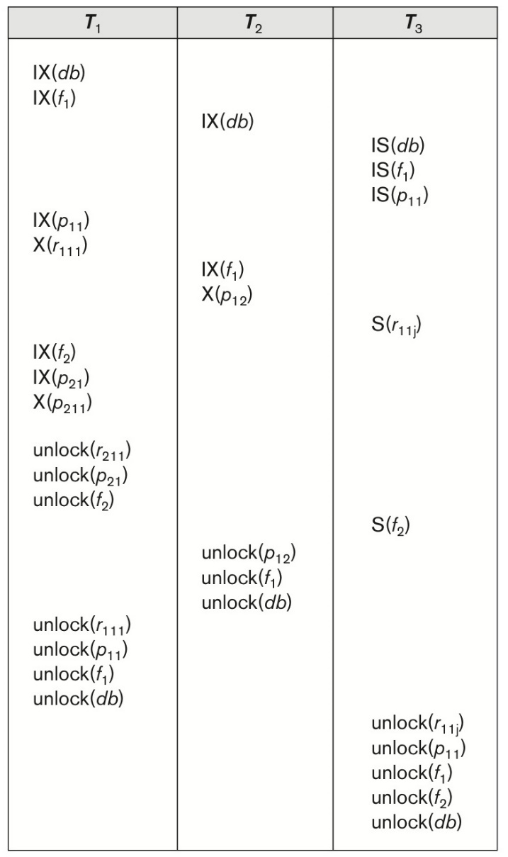
Granularity Hierarchy
T1 updates r₁₁₁ and r₂₁₁
T2 updates all records on p12.
T3 reads record r_{11j} and the entire f2.
Lock compatibility matrix

Slide 43
The Phantom Phenomenon
SELECT | SUM(balance)
FROM | account
WHERE | branch-name=‘Boca Raton’
T1
T2
INSERT INTO | account
VALUES | (S, ‘Deerfield Beach’, 900)
New Item !!
If concurrency control is performed at the tuple granularity, then this conflict cannot be detected.
One solution is to use index locking.

Slide 44
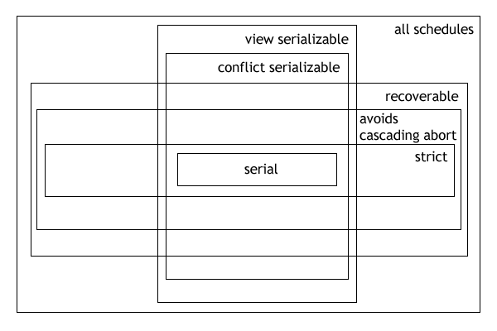
Types of Schedules in DBMS

Slide 45
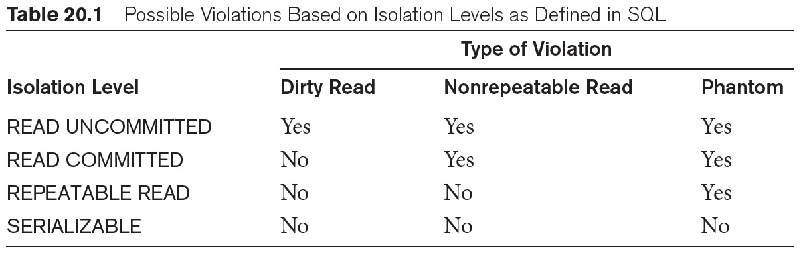
Isolation Level
The READ COMMITTED isolation level states that a transaction reads data that has been committed in the database. There are no dirty reads. There may be nonrepeatable reads (i.e., rereads of the same row may return a different answer in the same transaction) and phantom reads (i.e., newly inserted and committed rows become visible to a query that was not visible earlier in the transaction).

Slide 46
Take home message
Serializability
Recoverability
Two Phase Locking
Time Stamp Ordering
Multi-version Scheme
Optimistic Concurrency Control
Multiple Granularity
Phantom Phenomenon

Slide 47
Optional Topics

Slide 48
Optimistic Concurrency Control

Slide 49
Optimistic Concurrency Controls
In cases where a majority of transactions are read-only transactions, the rate of conflicts among transactions may be low.
Three phases:
Read phase
Validation phase
Write phase

Slide 50
Optimistic Concurrency Controls
Read phase:
Transaction T can read values of committed data items. However, updates are applied only to local copies (versions) of the data items (in database cache).
2. Validation Phase:
A transaction performs a validation test to determine whether data items can be copied to the database.
3. Write Phase:
If a transaction successfully completes the validation (step 2), then the system applies the actual updates to the database. Otherwise, the system rolls back.

Slide 51
Optimistic Concurrency Controls
Every transaction T_{i} is assigned a timestamp TS(T_{i}) at the beginning of its validation phase.
Assume that TS(T1) < TS(T2). T2 is valid if
T1 completes all three phases before T2 begins.
T1 completes before T2’s write phase and T1 does not write any item read by T2 (WriteSet(T1) ∩ ReadSet(T2) = empty)
T1 completes its read phase before T2 completes its read phase, and T1 does not write any item read or written by T2 (e.g., WriteSet(T1) ∩ ReadSet(T2) = empty and
WriteSet(T1) ∩ WriteSet(T2) = empty )

Slide 52
Optimistic Concurrency Controls
The validation scheme automatically guards against cascading rollbacks.
There is a possibility of starvation of long transactions.
Optimistic: Validation
Pessimistic: Locking and Time Stamp

Slide 53
Optimistic Concurrency Control
Dealing with Deadlock and Starvation
Transactions proceed in three phases:
READ: Transactions can read from the database but make changes to private copies of objects.
VALIDATION: If there is a possible conflict, the transaction is aborted, the private copy is cleared.
WRITE: The private copy will be stored in the database.
Each transaction is assigned a numeric id (i.e., timestamp) at the end of the READ phase (e.g., TS(T1)), just before validation begins.

Slide 54
Optimistic Concurrency Control
Three Phases: READ, VALIDATION, WRITE
ReadSet(T1): set of objects read by Xact T1
WriteSet(T1): set of objects modified by Xact T1
Validation Condition
Assume that TS (T1) < TS (T2)
T1 completes all three phases before T2 begins.
T1 completes before T2 starts WRITE phase, and T1 does not write any database object read by T2.
T1 completes READ phase before T2 completes READ phases and T1 does not write any database object that is either read or written by T2.
T1:RVW
T2: RVW
No WR and WW conflict
T1:RVW
T2: RVW
WriteSet(T1) ∩ ReadSet(T2) = empty, No WW conflict
WriteSet(T1) ∩ ReadSet(T2) = empty
WriteSet(T1) ∩ WriteSet(T2) = empty
T1:RVW
T2: RVW

Slide 55
Test 1
For all i and j such that Ti < Tj, check that Ti completes before Tj begins.
Ti
Tj
R
V
W
R
V
W

Slide 56
Test 2
For all i and j such that Ti < Tj, check that:
Ti completes before Tj begins its Write phase
WriteSet(Ti) ∩ ReadSet(Tj) is empty.
Ti
R
V
W
Tj
R
V
W
Does Tj read dirty data?
Does Ti overwrite Tj’s writes?

Slide 57
Test 3
For all i and j such that Ti < Tj, check that:
Ti completes Read phase before Tj does
WriteSet(Ti) ∩ ReadSet(Tj) is empty
WriteSet(Ti) ∩ WriteSet(Tj) is empty.
Ti
R
V
W
Tj
R
V
W
Does Tj read dirty data?
Does Ti overwrite Tj’s writes?

Slide 58
Timestamp Ordering (TO)

Slide 59
Timestamp Ordering (TO)
Timestamp based concurrency control algorithm
Timestamp Ordering
Do not use locks, hence, deadlocks never occur.
Timestamp based algorithm uses timestamp to serialize the execution of concurrent transactions.
Ensure conflict serializability because conflicting operations are processed in timestamp order.
Not recoverable

Slide 60
Timestamp Ordering (TO)
Timestamp based concurrency control algorithm
Each transaction T_{i,} is associated with an unique fixed timestamp TS(T_{i}) at the beginning of Xact.
If a transaction T_{i} has been assigned timestamp TS(T_{i}), and a new transaction T_{j} enters the system, then TS(T_{i}) < TS(T_{j})

Slide 61
Timestamp Ordering
Read to late: T2 started after T1, but wrote a value for X before T1 reads X.
T2 writes X
T1 reads X
T1 start
T2 start
Transaction T1 tries to read too later

Slide 62
Timestamp Ordering
Write too late: T2 started after T1, but read X before T1 got a chance to write X.
T2 reads X
T1 writes X
T1 start
T2 start
Transaction T1 tries to write too late

Slide 63
Timestamp Ordering
Define timestamps of data items
Read_TS(X): The largest timestamp among all the timestamps of transactions that have successfully read X.
Write_TS(X): The largest timestamp among all the timestamps of transactions that have successfully write X.
When T tries to read (X)
If TS(T) < write_TS(X), then X was written by a “later” transaction.
When T tries to write (X)
if TS(T) < read_TS(X) or TS(T) < write_TS(X), then X has been read or written by a “later” transaction.
read_item(X): TS(T) ≥ write_TS(X)
write_item(X): TS(T) ≥ read_TS(X) and TS(T) ≥ write_TS(X)

Slide 64
Database Concurrency Control
Timestamp based concurrency control algorithm
Basic Timestamp Ordering
Given Transaction T and item X
1. T issues read_item(X) operation:
If TS(T) < write_TS(X), then abort and roll-back T
SET read_TS(X) ← max ( TS(T), the current read_TS(X) ).
2. T issues write_item(X) operation:
If TS(T) < read_TS(X), then abort and roll-back T
if TS(T) < write_TS(X), then abort and roll-back T
SET write_TS(X) ← TS(T).
read_item(X): TS(T) ≥ write_TS(X)
write_item(X): TS(T) ≥ read_TS(X) and TS(T) ≥ write_TS(X)

Slide 65
Timestamp Ordering
TS(T1) =1, TS(T2) = 3
Time | T1 | T2
1 | Read(A)
2 | Write(A)
3 |  | Read(A)
4 |  | Write(A)
5 | Read(B)
6 | Write(B)
7 |  | Read(B)
8 |  | Write(B)
TS | Read_TS(A) | Write_TS(A) | Read_TS(B) | Write_TS(B)
1
2
3
4
5
6
7
8

Slide 66
Timestamp Ordering
TS(T1) =1, TS(T2) = 3
Time | T1 | T2
1 | Read(A)
2 | Write(A)
3 |  | Read(A)
4 |  | Write(A)
5 | Read(B)
6 | Write(B)
7 |  | Read(B)
8 |  | Write(B)
TS | Read_TS(A) | Write_TS(A) | Read_TS(B) | Write_TS(B)
1 | 1 | - | - | -
2 | - | - | - | -
3 | - | - | - | -
4 | - | - | - | -
5 | - | - | - | -
6 | - | - | - | -
7 | - | - | - | -
8 | - | - | - | -
If TS(T1) < write_TS(A), then abort and roll-back T
SET read_TS(A) ← max ( TS(T1), the current read_TS(A) )

Slide 67
Timestamp Ordering
TS(T1) =1, TS(T2) = 3
Time | T1 | T2
1 | Read(A)
2 | Write(A)
3 |  | Read(A)
4 |  | Write(A)
5 | Read(B)
6 | Write(B)
7 |  | Read(B)
8 |  | Write(B)
TS | Read_TS(A) | Write_TS(A) | Read_TS(B) | Write_TS(B)
1 | 1 | - | - | -
2 | 1 | 1 | - | -
3 | - | - | - | -
4 | - | - | - | -
5 | - | - | - | -
6 | - | - | - | -
7 | - | - | - | -
8 | - | - | - | -
If TS(T1) < read_TS(A), then abort and roll-back T
if TS(T1) < write_TS(A), then abort and roll-back T
SET write_TS(A) ← TS(T1).

Slide 68
Timestamp Ordering
TS(T1) =1, TS(T2) = 3
Time | T1 | T2
1 | Read(A)
2 | Write(A)
3 |  | Read(A)
4 |  | Write(A)
5 | Read(B)
6 | Write(B)
7 |  | Read(B)
8 |  | Write(B)
TS | Read_TS(A) | Write_TS(A) | Read_TS(B) | Write_TS(B)
1 | 1 | - | - | -
2 | 1 | 1 | - | -
3 | 3 | 1 | - | -
4 | - | - | - | -
5 | - | - | - | -
6 | - | - | - | -
7 | - | - | - | -
8 | - | - | - | -
If TS(T2) < write_TS(A), then abort and roll-back T
SET read_TS(A) ← max ( TS(T2), the current read_TS(A) )

Slide 69
Timestamp Ordering
TS(T1) =1, TS(T2) = 3
Time | T1 | T2
1 | Read(A)
2 | Write(A)
3 |  | Read(A)
4 |  | Write(A)
5 | Read(B)
6 | Write(B)
7 |  | Read(B)
8 |  | Write(B)
TS | Read_TS(A) | Write_TS(A) | Read_TS(B) | Write_TS(B)
1 | 1 | - | - | -
2 | 1 | 1 | - | -
3 | 3 | 1 | - | -
4 | 3 | 3 | - | -
5 | - | - | - | -
6 | - | - | - | -
7 | - | - | - | -
8 | - | - | - | -
If TS(T2) < read_TS(A), then abort and roll-back T
if TS(T2) < write_TS(A), then abort and roll-back T
SET write_TS(A) ← TS(T2).

Slide 70
Timestamp Ordering
TS(T1) =1, TS(T2) = 3
Time | T1 | T2
1 | Read(A)
2 | Write(A)
3 |  | Read(A)
4 |  | Write(A)
5 | Read(B)
6 | Write(B)
7 |  | Read(B)
8 |  | Write(B)
TS | Read_TS(A) | Write_TS(A) | Read_TS(B) | Write_TS(B)
1 | 1 | - | - | -
2 | 1 | 1 | - | -
3 | 3 | 1 | - | -
4 | 3 | 3 | - | -
5 | 3 | 3 | 1 | -
6 | - | - | - | -
7 | - | - | - | -
8 | - | - | - | -
If TS(T1) < write_TS(B), then abort and roll-back T
SET read_TS(B) ← max ( TS(T1), the current read_TS(B) )

Slide 71
Timestamp Ordering
TS(T1) =1, TS(T2) = 3
Time | T1 | T2
1 | Read(A)
2 | Write(A)
3 |  | Read(A)
4 |  | Write(A)
5 | Read(B)
6 | Write(B)
7 |  | Read(B)
8 |  | Write(B)
TS | Read_TS(A) | Write_TS(A) | Read_TS(B) | Write_TS(B)
1 | 1 | - | - | -
2 | 1 | 1 | - | -
3 | 3 | 1 | - | -
4 | 3 | 3 | - | -
5 | 3 | 3 | 1 | -
6 | 3 | 3 | 1 | 1
7 | - | - | - | -
8 | - | - | - | -
If TS(T1) < read_TS(B), then abort and roll-back T
if TS(T1) < write_TS(B), then abort and roll-back T
SET write_TS(B) ← TS(T1).

Slide 72
Timestamp Ordering
TS(T1) =1, TS(T2) = 3
Time | T1 | T2
1 | Read(A)
2 | Write(A)
3 |  | Read(A)
4 |  | Write(A)
5 | Read(B)
6 | Write(B)
7 |  | Read(B)
8 |  | Write(B)
TS | Read_TS(A) | Write_TS(A) | Read_TS(B) | Write_TS(B)
1 | 1 | - | - | -
2 | 1 | 1 | - | -
3 | 3 | 1 | - | -
4 | 3 | 3 | - | -
5 | 3 | 3 | 1 | -
6 | 3 | 3 | 1 | 1
7 | 3 | 3 | 3 | 1
8 | - | - | - | -
If TS(T2) < write_TS(B), then abort and roll-back T
SET read_TS(B) ← max ( TS(T2), the current read_TS(B) )

Slide 73
Timestamp Ordering
TS(T1) =1, TS(T2) = 3
Time | T1 | T2
1 | Read(A)
2 | Write(A)
3 |  | Read(A)
4 |  | Write(A)
5 | Read(B)
6 | Write(B)
7 |  | Read(B)
8 |  | Write(B)
TS | Read_TS(A) | Write_TS(A) | Read_TS(B) | Write_TS(B)
1 | 1 | - | - | -
2 | 1 | 1 | - | -
3 | 3 | 1 | - | -
4 | 3 | 3 | - | -
5 | 3 | 3 | 1 | -
6 | 3 | 3 | 1 | 1
7 | 3 | 3 | 1 | 1
8 | 3 | 3 | 3 | 3
If TS(T2) < read_TS(B), then abort and roll-back T
if TS(T2) < write_TS(B), then abort and roll-back T
SET write_TS(B) ← TS(T2).

Slide 74
Timestamp Ordering
TS(T1) =1, TS(T2) = 3
Time | T1 | T2
1 | Read(A)
2 | Write(A)
3 |  | Read(A)
4 |  | Write(A)
5 | Read(B)
6 | Write(B)
7 |  | Read(B)
8 |  | Write(B)
TS | Read_TS(A) | Write_TS(A) | Read_TS(B) | Write_TS(B)
1 | 1 | - | - | -
2 | 1 | 1 | - | -
3 | 3 | 1 | - | -
4 | 3 | 3 | - | -
5 | 3 | 3 | 1 | -
6 | 3 | 3 | 1 | 1
7 | 3 | 3 | 1 | 1
8 | 3 | 3 | 3 | 3
Is it conflict serializable?

Slide 75
Timestamp Ordering
TS(T1) =1, TS(T2) = 2
Time | T1 | T2
1 | Read(A)
2 |  | Read(A)
3 |  | Write(A)
4 |  | Read(B)
5 | Write(A)
6 | Read(B)
7 | Write(B)
8 |  | Write(B)
TS | Read_TS(A) | Write_TS(A) | Read_TS(B) | Write_TS(B)
1
2
3
4
5
6
7
8

Slide 76
Timestamp Ordering
TS(T1) =1, TS(T2) = 2
Time | T1 | T2
1 | Read(A)
2 |  | Read(A)
3 |  | Write(A)
4 |  | Read(B)
5 | Write(A)
6 | Read(B)
7 | Write(B)
8 |  | Write(B)
TS | Read_TS(A) | Write_TS(A) | Read_TS(B) | Write_TS(B)
1 | 1 | - | - | -
2
3
4
5
6
7
8
If TS(T1) < write_TS(A), then abort and roll-back T
SET read_TS(A) ← max ( TS(T1), the current read_TS(A) )

Slide 77
Timestamp Ordering
TS(T1) =1, TS(T2) = 2
Time | T1 | T2
1 | Read(A)
2 |  | Read(A)
3 |  | Write(A)
4 |  | Read(B)
5 | Write(A)
6 | Read(B)
7 | Write(B)
8 |  | Write(B)
TS | Read_TS(A) | Write_TS(A) | Read_TS(B) | Write_TS(B)
1 | 1 | - | - | -
2 | 2 | - | - | -
3
4
5
6
7
8
If TS(T2) < write_TS(A), then abort and roll-back T
SET read_TS(A) ← max ( TS(T2), the current read_TS(A) )

Slide 78
Timestamp Ordering
TS(T1) =1, TS(T2) = 2
Time | T1 | T2
1 | Read(A)
2 |  | Read(A)
3 |  | Write(A)
4 |  | Read(B)
5 | Write(A)
6 | Read(B)
7 | Write(B)
8 |  | Write(B)
TS | Read_TS(A) | Write_TS(A) | Read_TS(B) | Write_TS(B)
1 | 1 | - | - | -
2 | 2 | - | - | -
3 | 2 | 2 | - | -
4
5
6
7
8
If TS(T2) < read_TS(A), then abort and roll-back T
if TS(T2) < write_TS(A), then abort and roll-back T
SET write_TS(A) ← TS(T2).

Slide 79
Timestamp Ordering
TS(T1) =1, TS(T2) = 2
Time | T1 | T2
1 | Read(A)
2 |  | Read(A)
3 |  | Write(A)
4 |  | Read(B)
5 | Write(A)
6 | Read(B)
7 | Write(B)
8 |  | Write(B)
TS | Read_TS(A) | Write_TS(A) | Read_TS(B) | Write_TS(B)
1 | 1 | - | - | -
2 | 2 | - | - | -
3 | 2 | 2 | - | -
4 | 2 | 2 | 2 | -
5
6
7
8
If TS(T2) < write_TS(B), then abort and roll-back T
SET read_TS(B) ← max ( TS(T2), the current read_TS(B) )

Slide 80
Timestamp Ordering
TS(T1) =1, TS(T2) = 2
Time | T1 | T2
1 | Read(A)
2 |  | Read(A)
3 |  | Write(A)
4 |  | Read(B)
5 | Write(A)
6 | Read(B)
7 | Write(B)
8 |  | Write(B)
TS | Read_TS(A) | Write_TS(A) | Read_TS(B) | Write_TS(B)
1 | 1 | - | - | -
2 | 2 | - | - | -
3 | 2 | 2 | - | -
4 | 2 | 2 | 2 | -
5
6
7
8
If TS(T1) < read_TS(A), then abort and roll-back T
if TS(T1) < write_TS(A), then abort and roll-back T
SET write_TS(A) ← TS(T1).

Slide 81
Timestamp Ordering
TS(T1) =1, TS(T2) = 2
Time | T1 | T2
1 | Read(A)
2 |  | Read(A)
3 |  | Write(A)
4 |  | Read(B)
5 | Write(A)
6 | Read(B)
7 | Write(B)
8 |  | Write(B)
TS | Read_TS(A) | Write_TS(A) | Read_TS(B) | Write_TS(B)
1 | 1 | - | - | -
2 | 2 | - | - | -
3 | 2 | 2 | - | -
4 | 2 | 2 | 2 | -
5 |  | ?
6
7
8
Is it conflict serializable?
Transaction T issues a write_item(X) operation:
write_item(X): TS(T) ≥ read_TS(X) and TS(T) ≥ write_TS(X)

Slide 82
Timestamp Ordering
Dirty Read: It is possible that after T1 reads the value of X written by T2, transaction T2 will abort.
T2 writes X
T1 reads X
T2 start
T1 start
T2 aborts
T could perform a dirty read if it reads X when shown.

Slide 83
Database Concurrency Control
Timestamp based concurrency control algorithm
Strict Timestamp Ordering
1. T1 issues write_item(X) operation:
If TS(T1) > read_TS(X), then delay T1 until T2 that wrote or read X has terminated (committed or aborted).
2. T2 issues read_item(X) operation:
If TS(T1) > write_TS(X), then delay T1 until T2 that wrote or read X has terminated (committed or aborted).

Slide 84
Multi-version schemes

Slide 85
Multi-version concurrency control
Multi-version schemes keep old versions of data item to increase concurrency.
Multi-version Timestamp Ordering
Multi-version Two-Phase Locking
Every successful write operation create a new version of the data item written.
Use timestamps to label versions.
When Read(X) operation is issued, select an appropriate version of X based on the timestamp of the transaction, and return the value of the selected version.
Read operations never have to wait as an appropriate version is returned immediately.

Slide 86
Multi-version concurrency control
Multi-version concurrency control techniques
Side effect:
Significantly more storage (RAM and disk) is required to maintain multiple versions
Temporal Database

